Slide 1

ML24/25-05 Implement Performance Measurement Experiment
Course: Software Engineering
Lecturer: Damir Dobric / Andreas Pech
Presented by:
Tanvir Ahmed
Matriculation No. # 1386435

Slide 2
OBJECTIVE
The primary goal is to implement a performance measurement experiment in console app to run experiment with variable measurement values which also enables to run any experiment, especially MultiSequence Learning experiment.

Slide 3
TABLE OF CONTENT
INTRODUCTION
BACKGROUND
METHODOLOGY
IMPLEMENTATION
RESULTS
CONCLUSION
REFERENCE

Slide 4
INTRODUCTION
Multi-sequence learning with HTM entails teaching the algorithm to detect and anticipate patterns in multiple input sequences.
To perform multi-sequence learning using HTM, we must first encode the input information into Sparse Distributed Representations (SDRs), which can be accomplished with a scalar encoder.
After the data has been encoded, the spatial pooler generates sparse illustrations of the input sequences that are supplied into the temporal memory element for learning and prediction.
Using Argument parsing from the command line the experiment runs to calculate the learning time for the variable measurement values.

Slide 5
BACKGROUND
HIERARCHICAL TEMPORAL MEMORY (HTM)
SPARSE DISTRIBUTED REPRESENTATION (SDR)
ENCODER
SPATIAL POOLER
TEMPORAL MEMORY

Slide 6
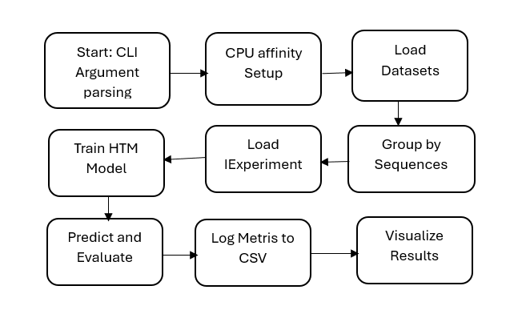
METHODOLOGY
Overview of the experiment:

Slide 7
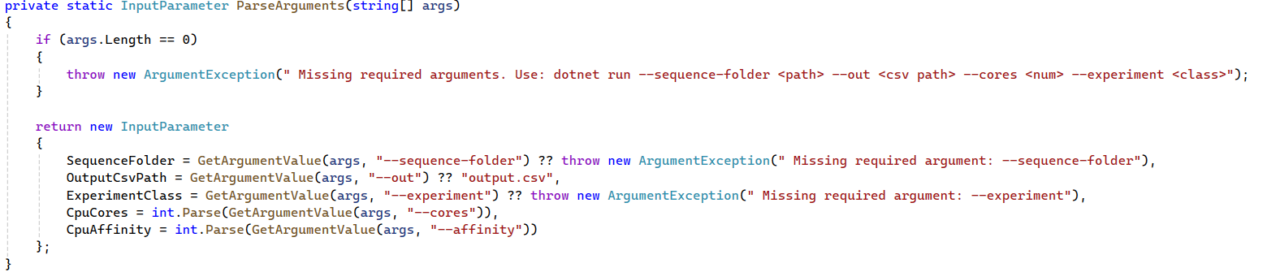
IMPLEMENTATION
Experiment Configuration and Argument Parsing:
--sequence-folder <path> --out <output.csv> --cores 1 --affinity 1 --experiment MultiSequenceLearning

Slide 8

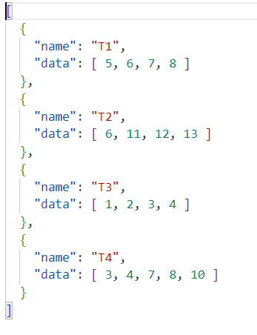
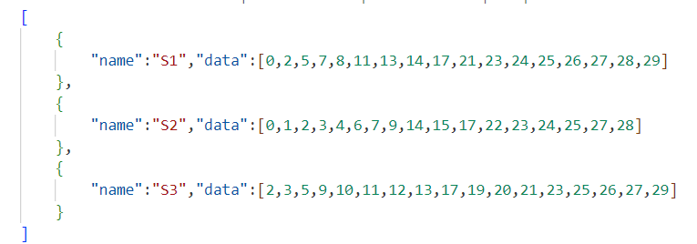
IMPLEMENTATION
DATA MODEL:
The sequence represents the model for processing and storing the dataset.

Slide 9
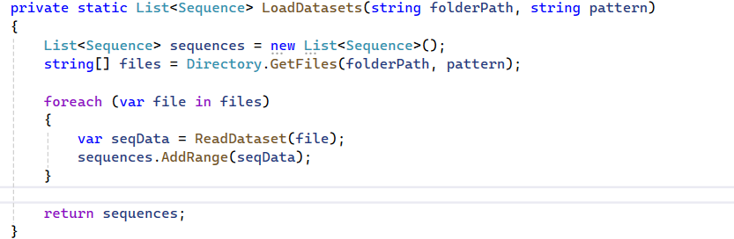
IMPLEMENTATION:
Dataset Loading:
LoadDataset()

Slide 10
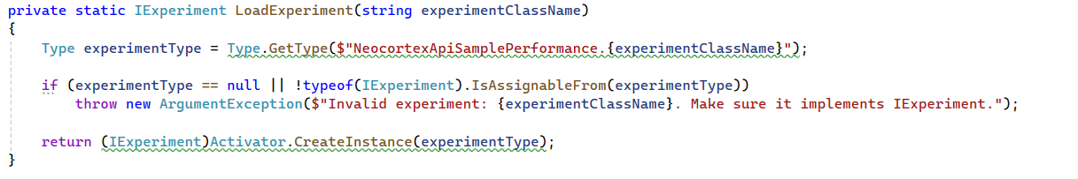
IMPLEMENTATION
IExperiment for loading experiment :
LoadExperiment()

Slide 11
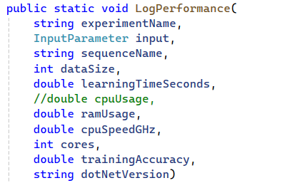
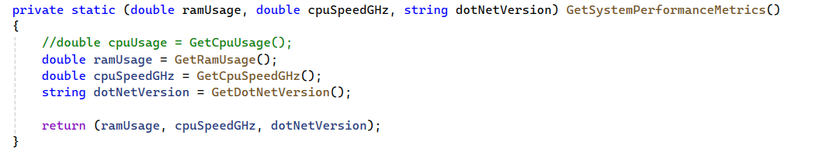
IMPLEMENTATION
Performance Logging:
PerformanceLogger.LogPerformance ()

Slide 12
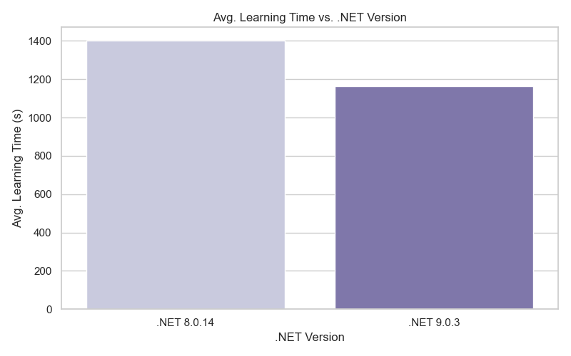
RESULTS
Learning time vs .NET Version

Slide 13
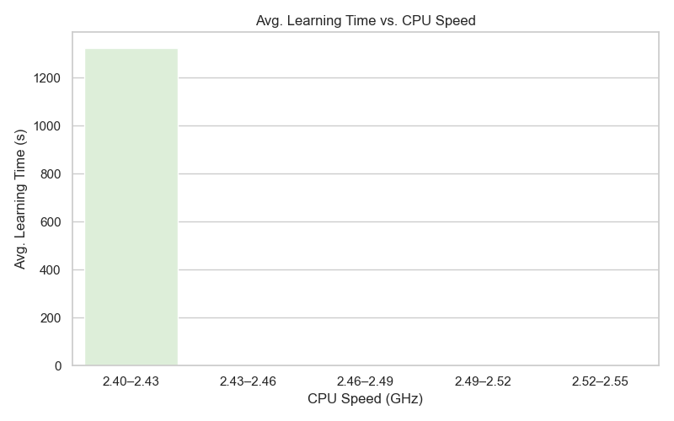
RESULTS
Learning time vs CPU Speed

Slide 14
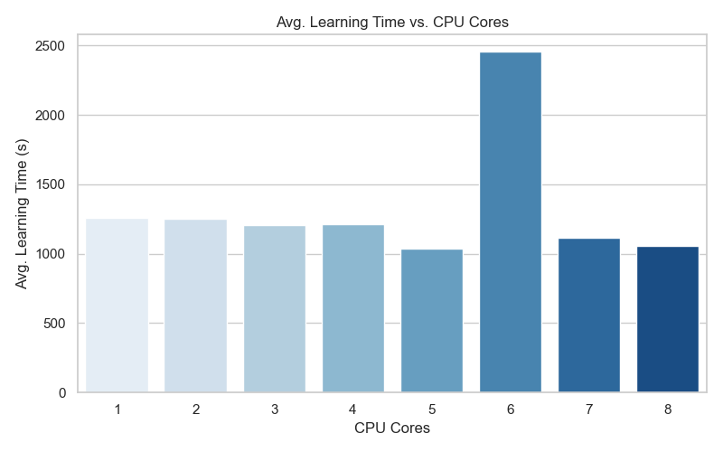
RESULTS
Learning time vs CPU Cores

Slide 15
CONCLUSION
This project effectively implements a modular and extensible experimental framework for evaluating the effectiveness of learning based on Hierarchical Temporal Memory (HTM), particularly the MultiSequence Learning model. During execution, a console-based runner with configurable parameters allowed for dynamic control over CPU affinity, core selection, and.NET runtime versions.
Important performance indicators were recorded in CSV outputs, including runtime versions, CPU speed, RAM utilization, and learning time. The experiment's findings supported the benefit of parallelization by demonstrating a correlation between CPU core count and learning efficiency. Additionally, a comparison of the various dotnet versions revealed notable runtime improvements, with.NET 9.0.3 performing better than.NET 8.0.14 in the majority of settings. Because of its reflection-based experiment interface, this program is adaptable enough to be used for more extensive HTM testing and study.

Slide 16
REFERENCES:
Jeff Hawkins, "On Intelligence: How a New Understanding of the Brain will Lead to the Creation of Truly Intelligent Machines", 2004
B. H. J. L. R. .Rabiner, “An introduction to hidden Markov models,”," 1986. [Online]. Available: http://ai.stanford.edu/~pabbeel/depth_qual/Rabiner_Juang_hmms.pdf
Yudhi Adhitya,” IoT and Deep Learning-Based Farmer Safety System” 2023.[Online]. Available: https://www.researchgate.net/figure/Hierarchical-Temporal-Memory-HTM-algorithm-flowchart_fig2_369126441
Keele, "Sequence learning,” - B. A. C. G. J. D. S. W.," 1998. [Online]. Available: https://pubmed.ncbi.nlm.nih.gov/21227209/

Slide 17
Thank You

